Slide 1


DATA COMMUNICATION
CSE 225/233
WEEK-8, LESSON-2
MULTIPLEXING

Slide 2








































































Concept of Multiplexing
Whenever the bandwidth of a medium linking two devices is greater than the bandwidth needs of the devices, the link can be shared. Multiplexing is the set of techniques that allows the simultaneous transmission of multiple signals across a single data link. As data and telecommunications use increases, so does traffic.
We can accommodate this increase by continuing to add individual links each time a new channel is needed; or we can install higher-bandwidth links and use each to carry multiple signals.
Data Communication Lecture Series, Prof Dr. Md. Fokhray Hossain, May 2021

Slide 3









































































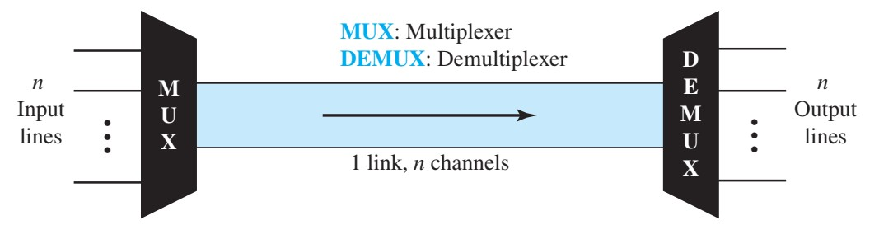
Dividing a link into channel
In a multiplexed system, n lines share the bandwidth of one link. Following figure shows the basic format of a multiplexed system. The lines on the left direct their transmission streams to a multiplexer (MUX), which combines them into a single stream (many-toone). At the receiving end, that stream is fed into a demultiplexer (DEMUX), which separates the stream back into its component transmissions (one-to-many) and directs them to their corresponding lines.
Data Communication Lecture Series, Prof Dr. Md. Fokhray Hossain, May 2021
Data Communication Lecture Series, Prof Dr. Md. Fokhray Hossain, May 2021

Slide 4





























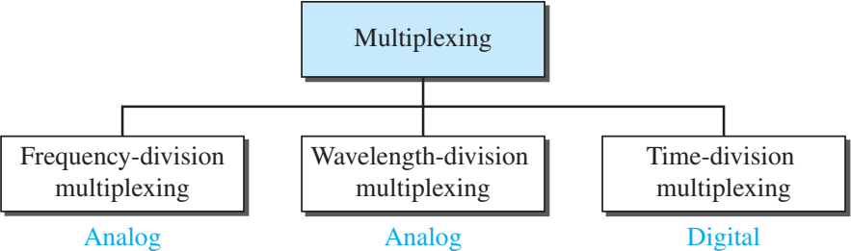
Categories of Multiplexing
There are three basic multiplexing techniques: frequency-division multiplexing, wavelength-division multiplexing, and time-division multiplexing. The first two are techniques designed for analog signals, the third, for digital signals
Data Communication Lecture Series, Prof Dr. Md. Fokhray Hossain, May 2021

Slide 5

























































































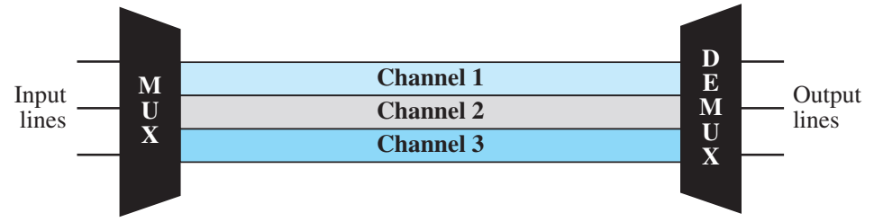
Frequency Division Multiplexing
Frequency-division multiplexing (FDM) is an analog technique that can be applied when the bandwidth of a link (in hertz) is greater than the combined bandwidths of the signals to be transmitted. In FDM, signals generated by each sending device modulate different carrier frequencies. These modulated signals are then combined into a single composite signal that can be transported by the link. Carrier frequencies are separated by sufficient bandwidth to accommodate the modulated signal. These bandwidth ranges are the channels through which the various signals travel. Channels can be separated by strips of unused bandwidth—guard bands—to prevent signals from overlapping.
Data Communication Lecture Series, Prof Dr. Md. Fokhray Hossain, May 2021

Slide 6















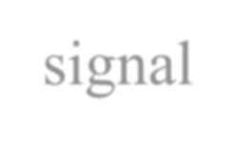
















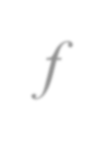
































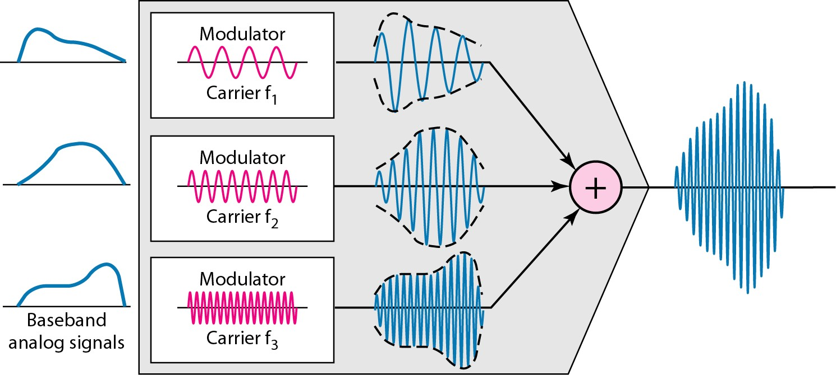
FDM Multiplexing Process
Following figure shows a conceptual illustration of the multiplexing process. Each source generates a signal of a similar frequency range. Inside the multiplexer, these similar signals modulate different carrier frequencies ( f1, f2, and f3). The resulting modulated signals are then combined into a single composite signal that is sent out over a media link that has enough bandwidth to accommodate it.

Slide 7










































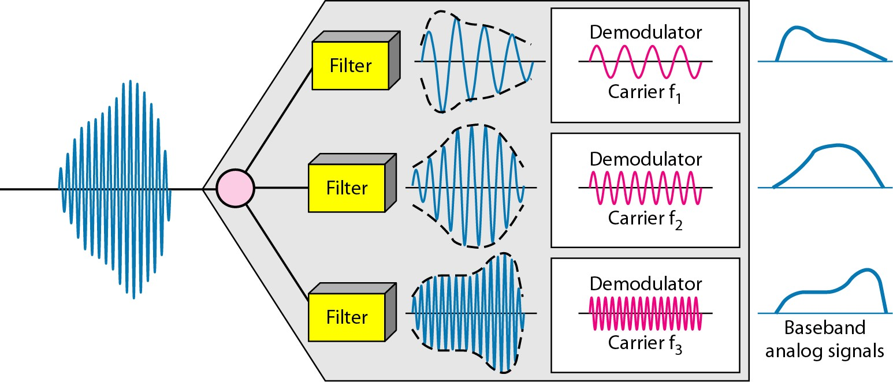
FDM De-Multiplexing Process
The demultiplexer uses a series of filters to decompose the multiplexed signal into its constituent component signals. The individual signals are then passed to a demodulator that separates them from their carriers and passes them to the output lines. Following figure shows a conceptual illustration of demultiplexing process.

Slide 8






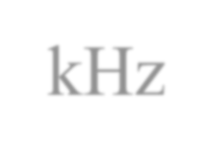











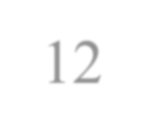
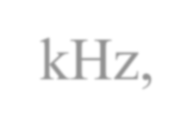

















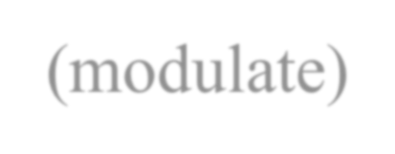


















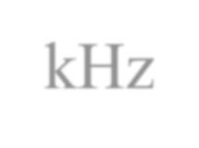

























Example (1)
Assume that a voice channel occupies a bandwidth of 4 kHz. We need to combine three voice channels into a link with a bandwidth of 12 kHz, from 20 to 32 kHz. Show the configuration, using the frequency domain. Assume there are no guard bands.
Solution
We shift (modulate) each of the three voice channels to a different bandwidth, as shown in Figure 6.6. We use the 20- to 24-kHz bandwidth for the first channel, the 24- to 28-kHz bandwidth for the second channel, and the 28- to 32-kHz bandwidth for the third one. Then we combine them as shown in the figure in the next slide.

Slide 9
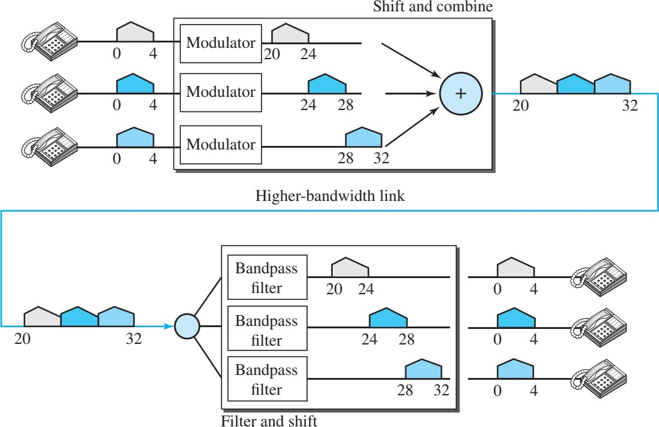
Example (Contd.)

Slide 10



















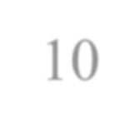


























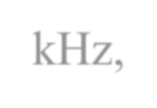
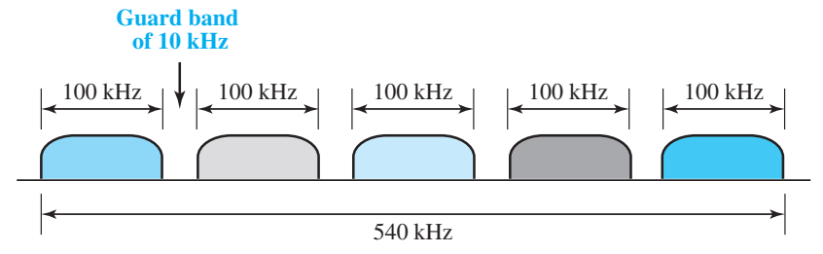
Example (2)
Five channels, each with a 100-kHz bandwidth, are to be multiplexed together. What is the minimum bandwidth of the link if there is a need for a guard band of 10 kHz between the channels to prevent interference?
Solution
For five channels, we need at least four guard bands. This means that the required bandwidth is at least
5 × 100 + 4 × 10 = 540 kHz,

Slide 11
Data Communication Lecture Series, Prof Dr. Md. Fokhray Hossain, May 2021

